Slide 1
2HSOE52 Introduction to Economics
Chapter 1 _E: Basic Statistical Concept
Test of Hypothesis
Samir K Mahajan, Ph.D. , UGC NET

Slide 2
A. Defining Hypothesis
A hypothesis is a statement or a claim or an assumption about the value of a population parameter (e.g., mean, median, variance, proportion, regression coefficient etc.).
In case of two or more populations a hypothesis is comparative statement or a claim or an assumption about the values of population parameters. (e.g., means of two populations are equal, variance of one population is greater than other, etc.)

Slide 3
A. Hypothesis: Examples
i. Customer of motorcycle may claim or postulate the hypothesis “the motorcycle of certain brand gives the average mileage 60 km/liter.”
Here, we are concerning the average mileage of the motorcycle so let µ represents the average mileage then our hypothesis becomes µ = 60 km / liter.
ii. the businessman of banana may write the statement or postulate the hypothesis “the average weight of a banana of Kerala is greater than 200 gm.” So our hypothesis becomes µ > 200 gm.

Slide 4
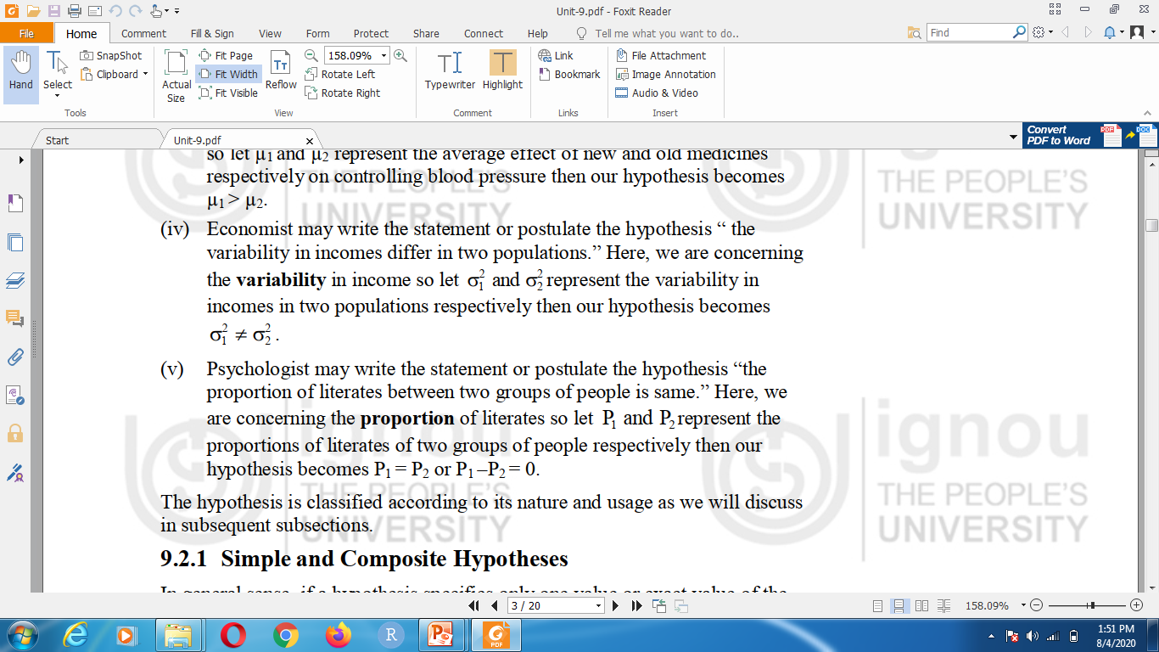
A. Hypothesis: Examples
iii. Doctor may write the claim or postulate the hypothesis “ the new medicine is really more effective for controlling blood pressure than old medicine.”
Let µ1 and µ2 represent the average effect of new and old medicines respectively on controlling blood pressure then our hypothesis becomes µ1 > µ2.

Slide 5
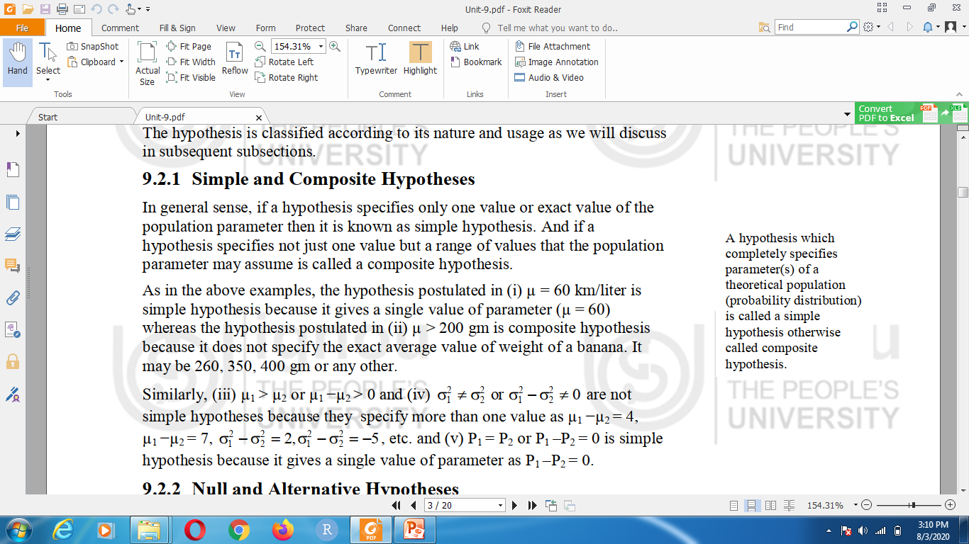
A. 1. Simple and Composite Hypothesis

Slide 6
A.3 Null and Alternative Hypotheses
A null hypothesis is derived from research hypothesis.
Null- Hypothesis :
Null Hypothesis (H₀) – a statistical hypothesis that states that there is no difference between a parameter and a specific value, or that there is no difference between two parameters or relationship between two measured phenomena or no association among groups.
Alternate Hypothesis :
The hypothesis which complements to the null hypothesis is called alternative hypothesis (often denoted H_{a} )
Alternative Hypothesis (H_{a} ) – a statistical hypothesis that states the existence of a difference between a parameter and a specific value, or states that there is a difference between two parameters.

Slide 7
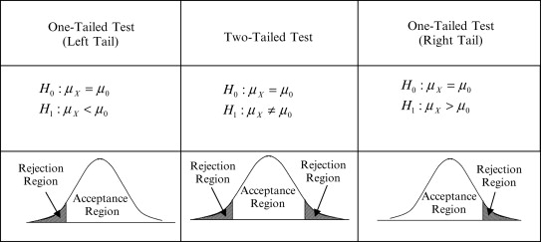
A.3.2 One Tailed and Two Tailed Statement of Hypothesis
The following are typical hypothesis for mean, where k is a specified value.
Left Tailed | Two-Tailed | Right Tailed
H₀ : µ >= k H_{a} : µ < k | H₀ : µ = k H_{a} : µ ≠ k | H₀ : µ <= k H_{a} : µ > k

Slide 8
B. Statistical test
After stating the hypotheses, the researcher designs the study
Select the correct statistical test
Choose an appropriate level of significance
Statistical Test – uses the data obtained from a sample to make a decision about whether the null hypothesis should be rejected.
Test Value or test statistic – the numerical value obtained from a statistical test

Slide 9
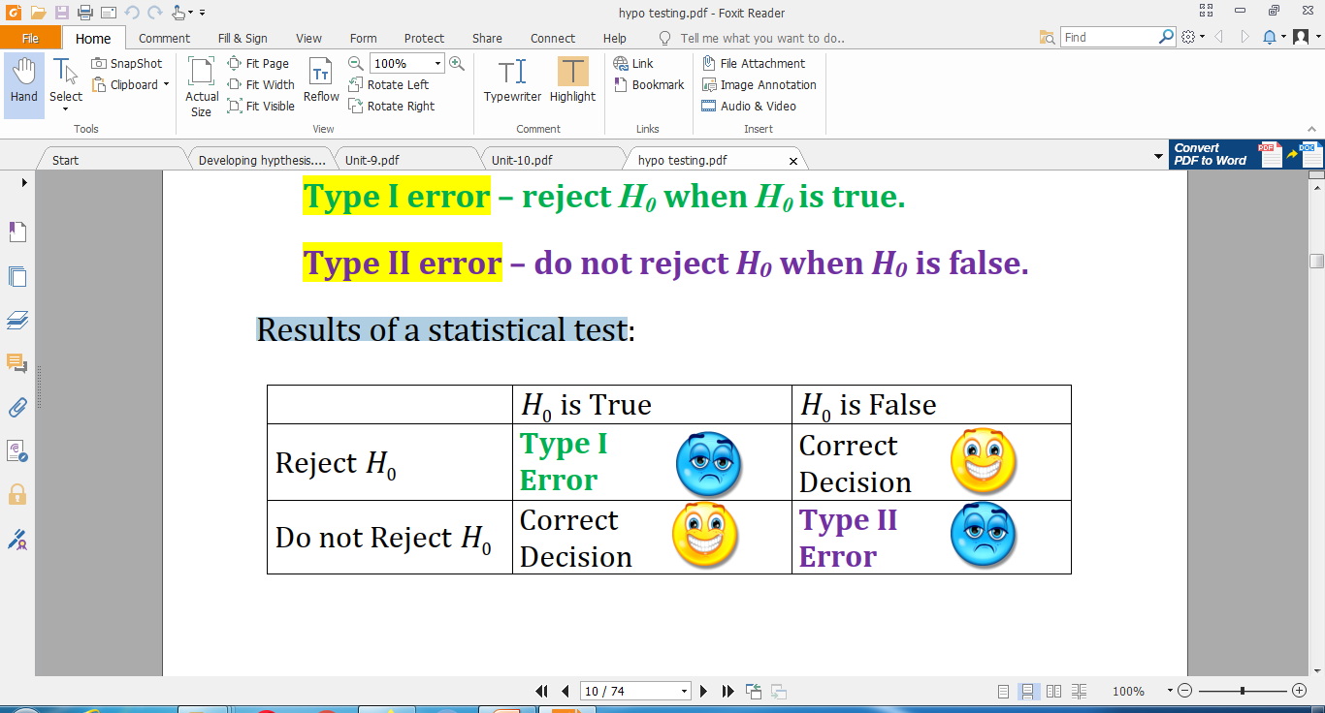
B.1 Errors in Statistical Test
A faulty sample misleads the inference (or conclusion) relating to the null hypothesis. Hence we can commit two kinds of errors while testing a hypothesis

Slide 10
B.1.2 Probability of Committing Type I Error : Significance level (α)
Significance level is the maximum probability of committing a Type I error. This probability is symbolized by α.
Generally, Significance level is pre-fixed as 5% or 1% level (α = 0.05 or 0.01)
The (1- α ) is called confidence level which is the probability of not –committing type I error i.e. probability of not-rejecting true null-hypothesis.
Confidence level correlates to the concept of 100(1- α )% confidence interval used in estimation.

Slide 11
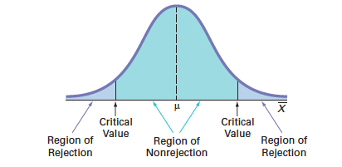
A. Estimator and Estimate

Slide 12
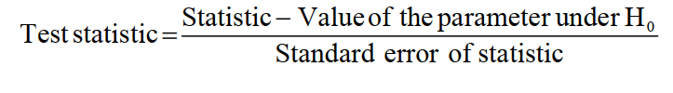
GENERAL PROCEDURE OF TESTING A HYPOTHESIS
Setup null hypothesis H₀ and alternative hypothesis H_{a}
Decide the level of significance ( α = 0.05 or 0.01), at which we want to test our hypothesis.
Choose an appropriate test statistic say (Z-test, t-test, F-test) under H₀ for testing the null hypothesis

Slide 13
GENERAL PROCEDURE OF TESTING A HYPOTHESIS
Calculate the value of the test statistic on the basis of observed sample observations
Obtain the critical/cut-off/tabulated value value(s) for a specified level of significance (α) in the sampling distribution of the test statistic such as Z-table, t-table, etc
Compare the calculated/observed value of test statistic with the critical /tabulated value for a specified level of significance (α) .

Slide 14
P-Value Method for Hypothesis Testing
Reach at a conclusion
If test /observed /calculated value is less than critical /tabulated value ( i.e. test value lies in rejection region ) at α level of significance then we do not reject null hypothesis.
If test value is more than critical value (i.e. test value lies in non-rejection region or do not fall in the critical region ) at α level of significance then we reject null hypothesis.

Slide 15
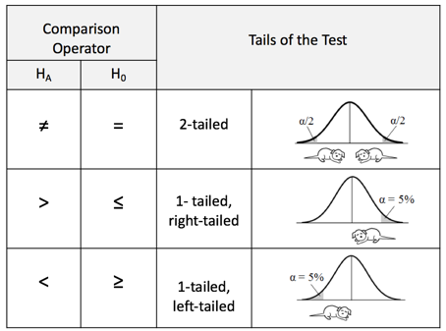
One-Tailed Test vs Two-Tailed Test
One-Tailed Test •
A one-tailed test indicates that the null hypothesis should be rejected when the test value is in the critical region on one side of the mean.
A one-tailed test is either left-tailed or right-tailed , depending on the direction of the inequality of the alternative hypothesis. (Note Look at Alternative Hypothesis )

Slide 16
One-Tailed Test vs Two-Tailed Test
Two-Tailed Test
In a two-tailed test , the null hypothesis should be rejected when the test value is in either of the two critical regions.

Slide 17
P-Value Method for Hypothesis Testing
The P-value or calculated probability is the actual/observed level of significance , and lies between 0 and 1. p-value is based on sample data.
The smaller the p-value, the stronger the evidence that you should reject the null hypothesis.
If the P-value is less than or equal to level of significance (α), then the null hypothesis is rejected in favor of the alternative hypothesis.
If the P-value is greater than , then the null hypothesis is not rejected.
A p-value less than equal ( ≤ )to 0.05 0r 0.01 (typically 0.05) is statistically significant.

Slide 18
Test- statistics
Different hypothesis tests use different test statistics based on the probability model assumed in the null hypothesis. Common tests and their test statistics include
Hypothesis test | Test statistic
Z-test | Z-statistic
t-tests | t-statistic
ANOVA | F-statistic
Chi-square tests | Chi-square statistic
:

